Slide 1
Fusing State Spaces for Markov Chain Monte Carlo Rendering
Hisanari Otsu¹ Anton S. Kaplanyan² Johannes Hanika³ Carsten Dachsbacher³ Toshiya Hachisuka¹
¹The University of Tokyo ²NVIDIA / Oculus Research ³Karlsruhe Institute of Technology
Notes:
Thank you for the introduction. I’ll talk on the research titled with ….

Slide 2
Monte Carlo (MC) rendering
Notes:
Rendering images are formulated by numerically solving an equation called the rendering equation. Most photorealistic rendering methods solve the equation with the Monte Carlo method.
Rendering with the Monte Carlo method generates random light paths connecting a light source and a sensor, [click*3] and estimates the energy contributed to the pixel on the sensor plane. [click]

Slide 3
Markov chain Monte Carlo (MCMC) rendering
Notes:
Recent and advanced approaches use Markov chain Monte Carlo (MCMC) for generating light paths. In MCMC rendering, light paths are sequentially generated based on the current light path.
For instance, a new light path can be generated by slightly changing the surface positions of the light path.

Slide 4
Markov chain Monte Carlo (MCMC) rendering
Accepted
Notes:
The generated light paths are determined to be accepted

Slide 5
Markov chain Monte Carlo (MCMC) rendering
Rejected
Notes:
or rejected according to the probability called acceptance ratio.
This process of changing the current state of the light path is called mutation.

Slide 6
Markov chain Monte Carlo (MCMC) rendering
Notes:
or rejected according to the probability called acceptance ratio.
This process of changing the current state of the light paths is called the mutation.

Slide 7
Efficiency of MCMC rendering
Notes:
The efficiency of the MCMC based approaches can be observed in this example. This scene is divided into two parts; [click] the left part contains a sensor [click] and the right part contains a light source [click]. The two parts are connected with a small gap [click].

Slide 8
Efficiency of MCMC rendering
Notes:
For this kind of scene, randomly generating light paths is difficult, because there is a low probability for the light path to be connected through the small gap [click].

Slide 9
Efficiency of MCMC rendering
Notes:
On the other hand, MCMC can find these paths once a path connecting the sensor and the light source is found, [click] [click] because MCMC can facilitate local exploration of paths.

Slide 10
Efficiency of MCMC rendering
Notes:
On the other hand, MCMC can find these paths once a path connecting the sensor and the light source is found, [click] [click] because MCMC can facilitate local exploration of paths.

Slide 11
Efficiency of MCMC rendering
Notes:
On the other hand, MCMC can find these paths once a path connecting the sensor and the light source is found, [click] [click] because MCMC can facilitate local exploration of paths.

Slide 12
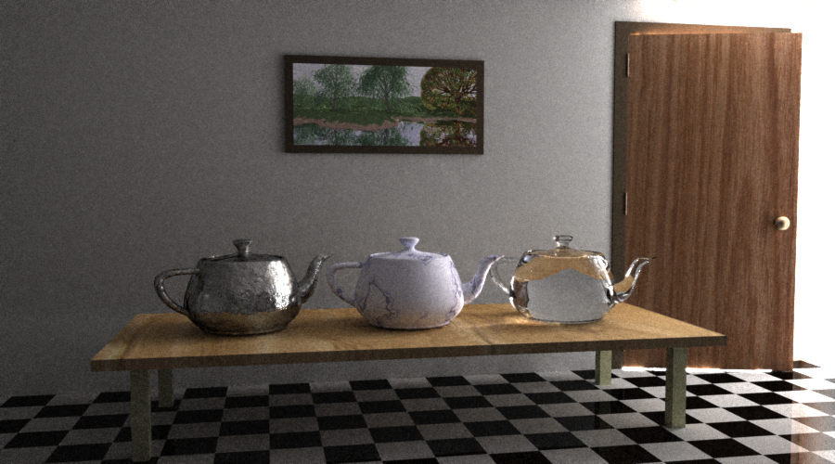
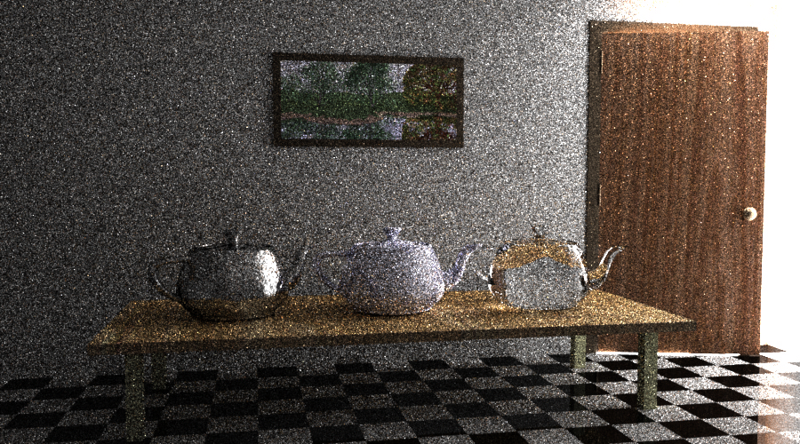
MCMC rendering
MC rendering
Notes:
This is a 3d scene with a similar configuration to the previous 2d example. The light source and the sensor are divided into two rooms, connected by a small gap of an open door. This side of the room is only illuminated with the light coming through from this gap.
MCMC rendering can render the image efficiently. The efficiency of the approaches can be observed by the noise on the image.

Slide 13
State spaces for MCMC rendering
Describes how a path is mathematically defined
Notes:
MCMC rendering needs to define the state space, in order to describe how a path is mathematically defined.
Mainly the state spaces in the recent MCMC rendering techniques are categorized into two groups.

Slide 14
Path space
$$x_{3}$$
$$x_{1}$$
$$x_{4}$$
$$x_{2}$$
[Veach & Guibas 1997]
Path is a sequence of surface points
Notes:
The first group is the path space. The path space is a collection of the paths represented by [click] a sequence of surface points.

Slide 15
Mutation in path space
Changes surface points directly
Notes:
In the path space [click], this mutation process is defined as an operation on the surface points, [click] by directly changing the positions of the surface points.

Slide 16
Mutation in path space
Changes surface points directly
Notes:
In the path space [click], this mutation process is defined as an operation on the surface points, [click] by directly changing the positions of the surface points.

Slide 17
Primary sample space
$$\left(u_{1},u_{2},u_{3},u_{4}\right)$$
$${\left[0,1\right]}^{N}$$
[Kelemen et al. 2002]
Path is a sequence of numbers
Notes:
On the other hand, the primary sample space [break], uses a sequence of numbers, for instance, random numbers.

Slide 18
Primary sample space
Path is a sequence of numbers
mapped to a sequence of surface points
Notes:
the number is [click] mapped to a light path through [click*2] a mapping to a sequence of surface points, [break] called the path sampler.

Slide 19
Primary sample space
Path sampler
Path is a sequence of numbers
mapped to a sequence of surface points
Notes:
the number is [click] mapped to a light path through [click*2] a mapping to a sequence of surface points, [break] called the path sampler.

Slide 20
Mutation in primary sample space
Changes surface points indirectly by changing corresponding numbers
Notes:
Instead of directly changing the surface points, the mutation performed in the primary sample space mutates the path indirectly [click] by changing the sequence of numbers.

Slide 21
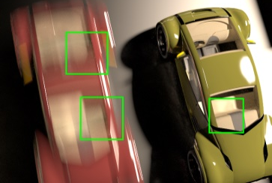
Existing mutation techniques
Path space
Primary sample space
[Veach & Guibas 1997]
[Kelemen et al. 2002]
[Jacob & Marschner 2012]
[Kaplanyan et al. 2014]
[Hachisuka et al. 2014]
[Li et al. 2015]
Notes:
Various advanced mutation strategies have been researched. However, due to the fundamental difference between the two state spaces, a mutation strategy for one space is not applicable to the other space.
For instance, [click]

Slide 22
Existing mutation techniques
Path space
Primary sample space
MEMLT
MMLT
[Jacob & Marschner 2012]
[Hachisuka et al. 2014]
+ local exploration
- local exploration
- global exploration
+ global exploration
Notes:
… the mutation strategies in manifold exploration [click] or MEMLT is good at local exploration because the mutation techniques in MLT [click] can recreate the paths efficiently.
On the other hand, for instance, [click] Multiplexed MLT which uses mutation techniques defined in primary sample space is less efficient at local exploration [click] because it needs to recreate entire paths in every mutation.
Conversely, multiplexed MLT is good at handling global exploration as [click] it facilitates important sampling in MCMC. On the other hand, in this case, [click] MEMLT is less efficient because a state in path space tends to be stuck in a local subspace.
We want to combine these two approaches in one framework to alleviate the trade-off. But actually we can’t [break] due to the difference of the state spaces.

Slide 23
Contribution
MCMC rendering framework to fuse state spaces
Combines mutation techniques for different state spaces into one framework
Introduces concept of inverse path sampler
Notes:
In order to resolve this issue, we propose a new MCMC rendering framework to fuse two different state spaces into one.
We will introduce a novel yet simple concept called the inverse path sampler, which makes it possible to connect the two different state spaces without modifying the underlying formulations.

Slide 24
Path sampler
$$x_{3}$$
$$x_{1}$$
$$x_{4}$$
$$x_{2}$$
$$\left(u_{1},u_{2},u_{3},u_{4}\right)$$
$$\left(x_{1},x_{2},x_{3},x_{4}\right)$$
Notes:
We will first explain how the mapping between the primary sample space and the path space is defined. We call the mapping that inputs a sequence of numbers [click], and outputs a sequence of surface points [click], the path sampler.

Slide 25
Path sampler
$$x_{1}=F_{1}\left(u_{1}\right)$$
$$\left(u_{1},u_{2},u_{3},u_{4}\right)$$
$$\left(x_{1},x_{2},x_{3},x_{4}\right)$$
Notes:
The construction of the path sampler is element-wise. Let’s assume we will construct the path from the side of the sensor [click]. First we can generate the first surface point x_1 from the number u_1 using the sampling function F_1.

Slide 26
Path sampler
$$x_{2}=F_{2}\left(u_{2}\right)$$
$$\left(u_{1},u_{2},u_{3},u_{4}\right)$$
$$\left(x_{1},x_{2},x_{3},x_{4}\right)$$
Notes:
Based on this point, we can generate the next surface point x_2, using the number u_2.

Slide 27
Path sampler
$$x_{3}=F_{3}\left(u_{3}\right)$$
$$\left(u_{1},u_{2},u_{3},u_{4}\right)$$
$$\left(x_{1},x_{2},x_{3},x_{4}\right)$$
Notes:
We will continue this process consuming the number and generating the surface points [click] until it finds a light source.

Slide 28
Path sampler
$$x_{4}=F_{4}\left(u_{4}\right)$$
$$\left(u_{1},u_{2},u_{3},u_{4}\right)$$
$$\left(x_{1},x_{2},x_{3},x_{4}\right)$$
Notes:
We will continue this process consuming the number and generating the surface points [click] until it finds a light source.

Slide 29
Path sampler
$$x_{3}$$
$$x_{1}$$
$$x_{4}$$
$$x_{2}$$
$$\left(u_{1},u_{2},u_{3},u_{4}\right)$$
$$\left(x_{1},x_{2},x_{3},x_{4}\right)$$
Notes:
Now we will introduce a new concept, the inverse path sampler.
The path sampler maps a sequence of numbers to a sequence of surface points.

Slide 30
Path sampler
$$x_{3}$$
$$x_{1}$$
$$x_{4}$$
$$x_{2}$$
$$\left(u_{1},u_{2},u_{3},u_{4}\right)$$
$$\left(x_{1},x_{2},x_{3},x_{4}\right)$$
Notes:
On the other hand, the inverse path sampler will do the opposite [click], mapping a sequence of surface points to a sequence of numbers.

Slide 31
Inverse path sampler
$$x_{3}$$
$$x_{1}$$
$$x_{4}$$
$$x_{2}$$
$$\left(x_{1},x_{2},x_{3},x_{4}\right)$$
Notes:
On the other hand, the inverse path sampler will do the opposite [click], mapping a sequence of surface points to a sequence of numbers.

Slide 32
Inverse path sampler
$$x_{3}$$
$$x_{1}$$
$$x_{4}$$
$$x_{2}$$
$$\left(x_{1},x_{2},x_{3},x_{4}\right)$$
$$\left(u_{1},u_{2},u_{3},u_{4}\right)$$
Notes:
On the other hand, the inverse path sampler will do the opposite [click], mapping a sequence of surface points to a sequence of numbers.

Slide 33
Inverse path sampler
$$x_{1}$$
$$u_{1}=F_{1}^{−1}\left(x_{1}\right)$$
$$\left(x_{1},x_{2},x_{3},x_{4}\right)$$
$$\left(u_{1},u_{2},u_{3},u_{4}\right)$$
Notes:
The inverse path sampler is easy to obtain, as we already know the sequence of surface points are generated element-wise by the sampler functions. We can subsequently compute the inverse of the elements. For instance, the surface point x_1 is generated from the number u_1 with function F_1. [click]
So we can easily obtain the number u_1 from the surface point x_1 by computing the inverse of the function F_1.

Slide 34
Inverse path sampler
$$u_{2}=F_{2}^{−1}\left(x_{2}\right)$$
$$x_{2}$$
$$\left(x_{1},x_{2},x_{3},x_{4}\right)$$
$$\left(u_{1},u_{2},u_{3},u_{4}\right)$$
Notes:
The computation for the other vertices is the same as the initial one. [click] Subsequently we can obtain the sequence of numbers [click] from the surface points.

Slide 35
Inverse path sampler
$$x_{3}$$
$$u_{3}=F_{3}^{−1}\left(x_{3}\right)$$
$$\left(x_{1},x_{2},x_{3},x_{4}\right)$$
$$\left(u_{1},u_{2},u_{3},u_{4}\right)$$
Notes:
The computation for the other vertices is the same as the initial one. [click] Subsequently we can obtain the sequence of numbers [click] from the surface points.

Slide 36
Inverse path sampler
$$x_{4}$$
$$u_{4}=F_{4}^{−1}\left(x_{4}\right)$$
$$\left(x_{1},x_{2},x_{3},x_{4}\right)$$
$$\left(u_{1},u_{2},u_{3},u_{4}\right)$$
Notes:
The computation for the other vertices is the same as the initial one. [click] Subsequently we can obtain the sequence of numbers [click] from the surface points.

Slide 37
Inverse path sampler
$F$ is the inverse cumulative distribution function (CDF)
Obtaining $F^{−1}$ (CDF) is straightforward because it is needed in the derivation of the inverse CDF
Example: GGX distribution
$$u_{1}=\frac{\tan^{2}{θ}}{{α^{2}+tan}^{2}{θ}}, u_{2}=\frac{φ}{2π}$$
$$θ$$
$$θ=\tan^{−1}{\frac{α\sqrt{u_{1}}}{\sqrt{1−u_{1}}}}, φ=2πu_{2}$$
$$φ$$
Notes:
You might be wondering how we could obtain F^-1 (F inverse) given F, but it turns out that the solution is simple in rendering. The function F is actually an inverse cumulative distribution (cdf). So Obtaining the F inverse is straightforward because we need it to derive the inverse CDF.
For instance, sampling a half-vector direction from ggx is [click] written in the equations, which corresponds to the function F. From the equations, [click] we can easily obtain the equations for u_1 and u_2, which corresponds to the inverse F.

Slide 38
Handling non-invertibility
Handling the case of $F^{−1}$ does not exist
e.g., perfect reflectors, layered material
Use of a mapping in lower dimensional subspace to define invertible mapping
Notes:
You also might wonder the case that F inverse does not exist.
For instance, the pdf for perfect reflectors contains a delta function. In this case, we cannot uniquely determine the inverse mapping, because no component in a sequence of numbers is used to generate a sample. To solve the issue, we introduced a mapping in the lower dimensional subspace of the base state space, by excluding all components related to the delta functions. The function F defined on the subspace becomes invertible.

Slide 39
Fusing mutations
With an inverse path sampler, we can fuse mutations in path space and primary sample space
Our state is defined in primary sample space
Notes:
Using the building blocks, the path sampler and the inverse path sampler, we will introduce a technique to fuse mutations from the different state spaces: the path space and the primary sample space.
Our method defines the state space as the primary sample space [click]. We want to note [break] the selection of the state space is not limited to the primary sample space.

Slide 40
Fusing mutations
Notes:
[click] Since we defined the sample space as the primary sample space, we can [click] directly apply primary sample space mutations to the current state.

Slide 41
Primary sample space mutations
Primary sample space mutation
Current state
Next state
Notes:
[click] Since we defined the sample space as the primary sample space, we can [click] directly apply primary sample space mutations to the current state.

Slide 42
Path space mutations
Map to
path space
Current state
Notes:
Next we want to integrate the path space mutations into this framework. The basic idea is to use the inverse path sampler in the mutation process.
In this mutation, we first [click] map the current state in the primary sample space into the path space using a path sampler.

Slide 43
Path space mutations
Map to
path space
Current state
Notes:
Next we will mutate the path with the path space mutation, [click*3] obtaining a next state in the path space.

Slide 44
Path space mutations
Path space mutation
Notes:
Next we will mutate the path with the path space mutation, [click*3] obtaining a next state in the path space.

Slide 45
Path space mutations
Path space mutation
Notes:
Next we will mutate the path with the path space mutation, [click*3] obtaining a next state in the path space.

Slide 46
Path space mutations
Path space mutation
Notes:
Next we will mutate the path with the path space mutation, [click*3] obtaining a next state in the path space.

Slide 47
Path space mutations
Path space mutation
Notes:
[click] Finally the mutated path is mapped back into the primary sample space, [click] using the inverse path sampler that we introduced in our method.

Slide 48
Path space mutations
Map to
Primary sample space
with inverse path sampler
Next state
Notes:
[click] Finally the mutated path is mapped back into the primary sample space, [click] using the inverse path sampler that we introduced in our method.

Slide 49
No need to change existing code for path space mutations!
Notes:
We can show that the proposed mutation technique does not change the formulation of the path space mutations. This means we don’t need to modify the existing code of the path space mutations.

Slide 50
Primary sample space mutation
Path space mutation
Notes:
As such, we can handle both of the path space mutations and the primary sample space mutations in one framework.

Slide 51
Primary sample space mutation
Path space mutation
Notes:
We note that this framework is also applicable to the case that the base state space is the path space.

Slide 52
Results
Render time: 20 mins, 6h~ for references
Compared techniques
Based on primary sample space
Multiplexed MLT [Hachisuka et al. 2014]
Based on path space
MEMLT [Jakob & Marschner 2012]
Proposed approach (Ours)
Multiplexed MLT + MEMLT
Notes:
Let’s move on to the results.
We render all of the images in 20 minutes, and the reference images for more than 6 hours.
We implemented and compared three different approaches: Multiplexed MLT, which is based on the primary sample space, MLT with manifold exploration, which is based on the path space, and our method, which combines both approaches.

Slide 53
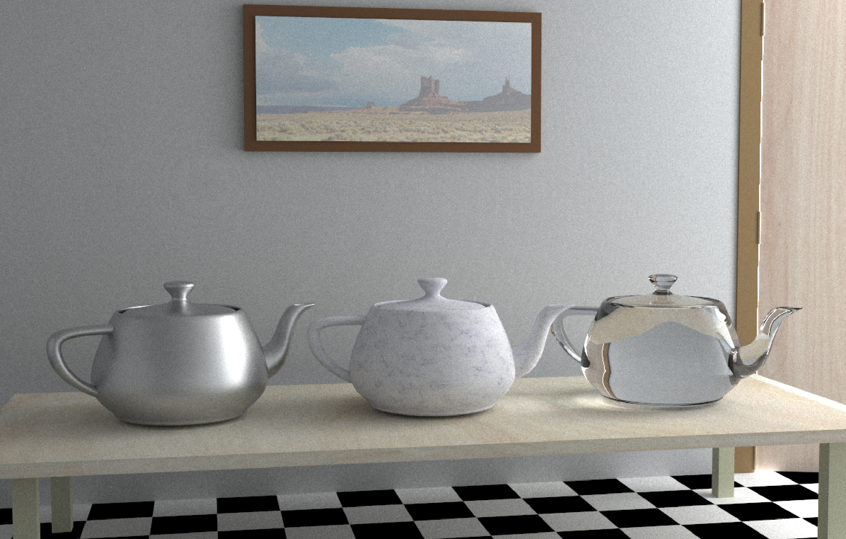
Reference
Notes:
The first scene contains diffuse, specular, and glossy surfaces indirectly illuminated by a light leaking through the slightly open door.

Slide 54
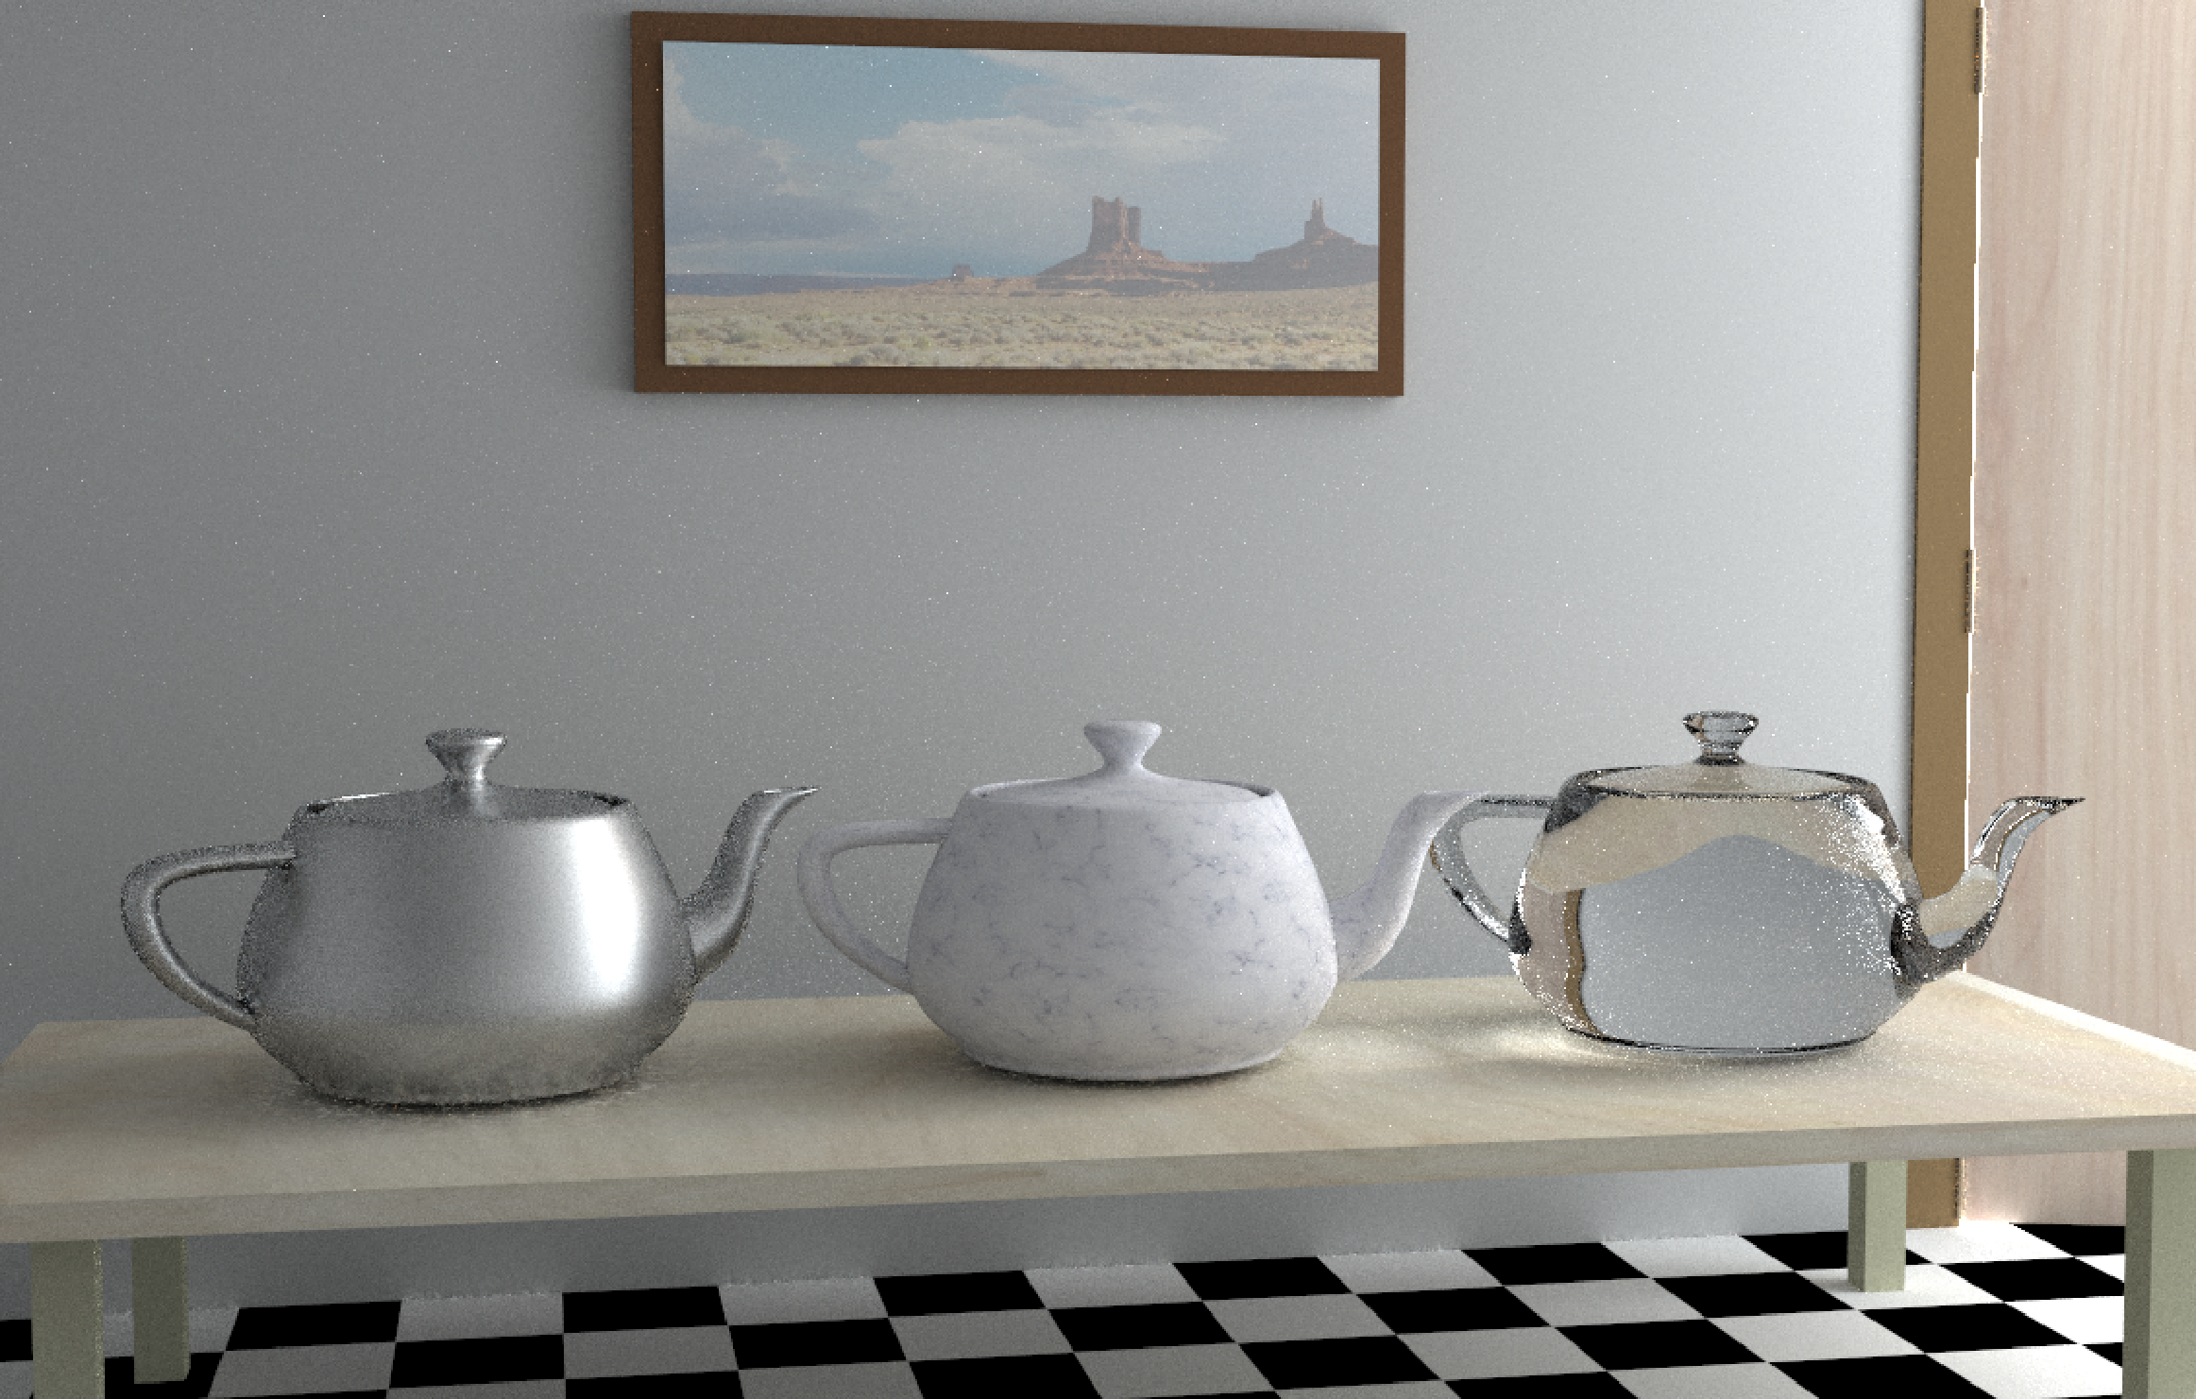
Path space (MLT)
Notes:
MLT can handle this scene well because of the efficient recreation of the paths.

Slide 55
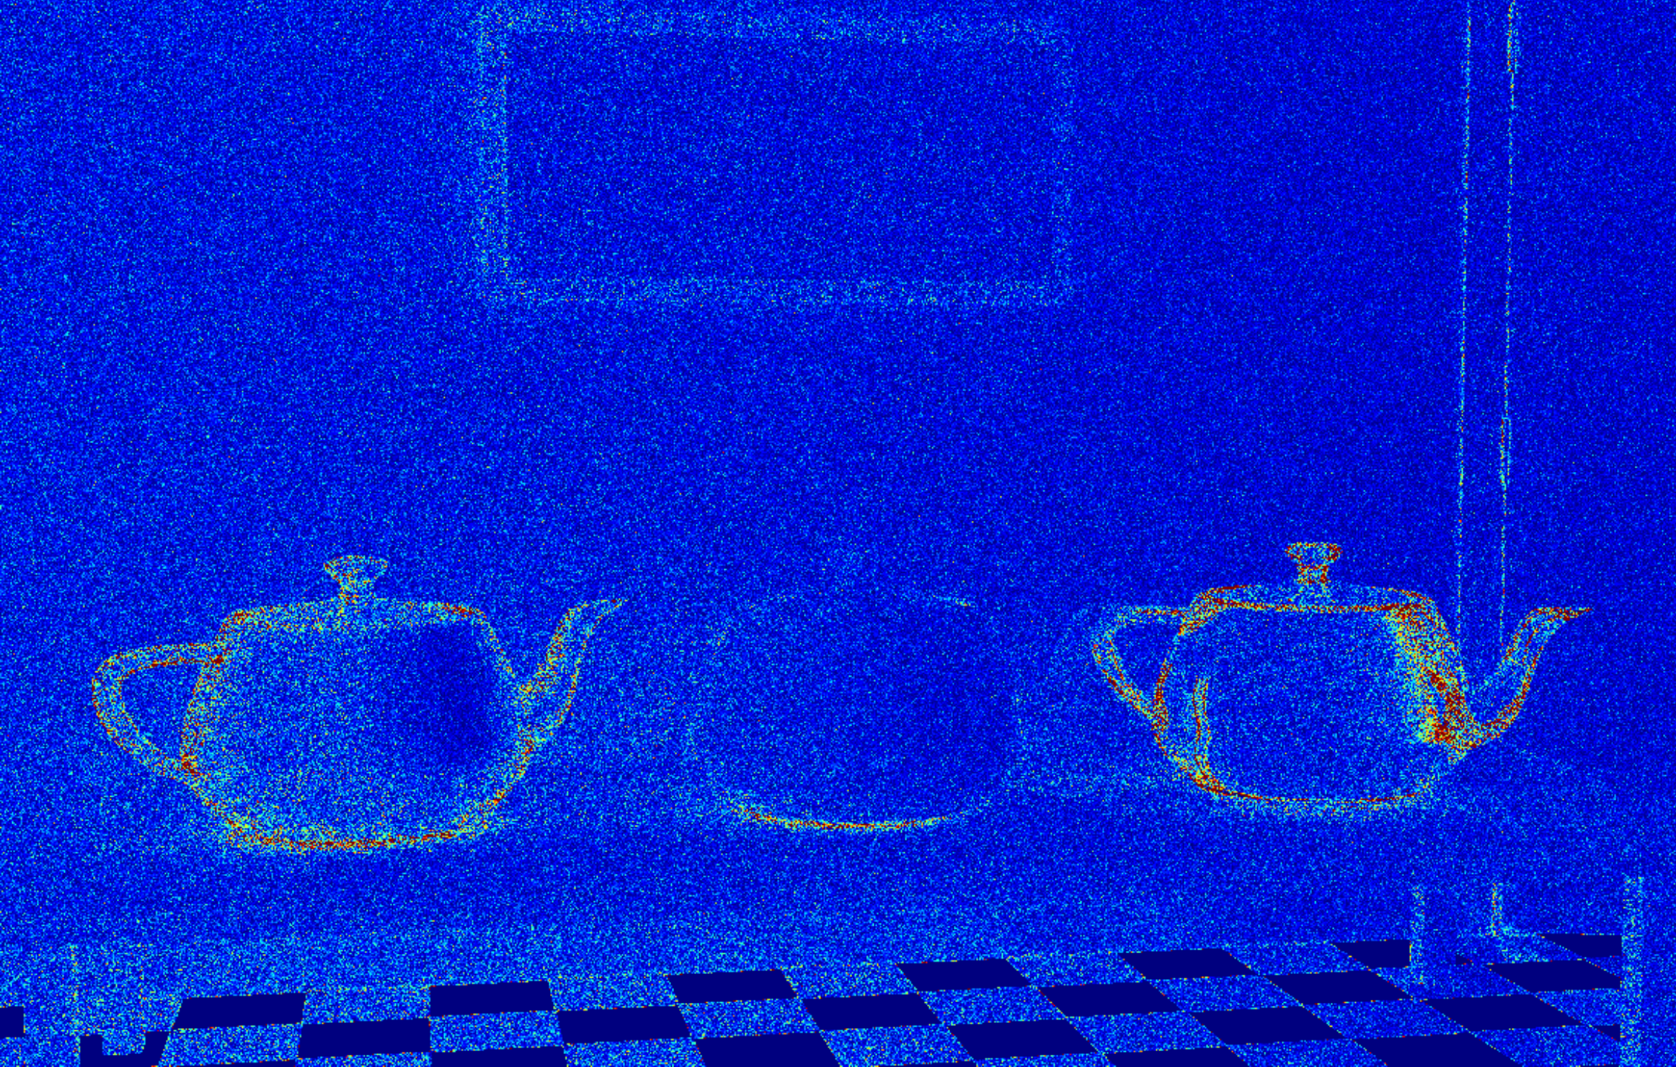
Path space (MLT)
Error: 0.2520
0.0
1.0
Notes:
This image shows the pixel-wise relative RMSE for MLT.

Slide 56
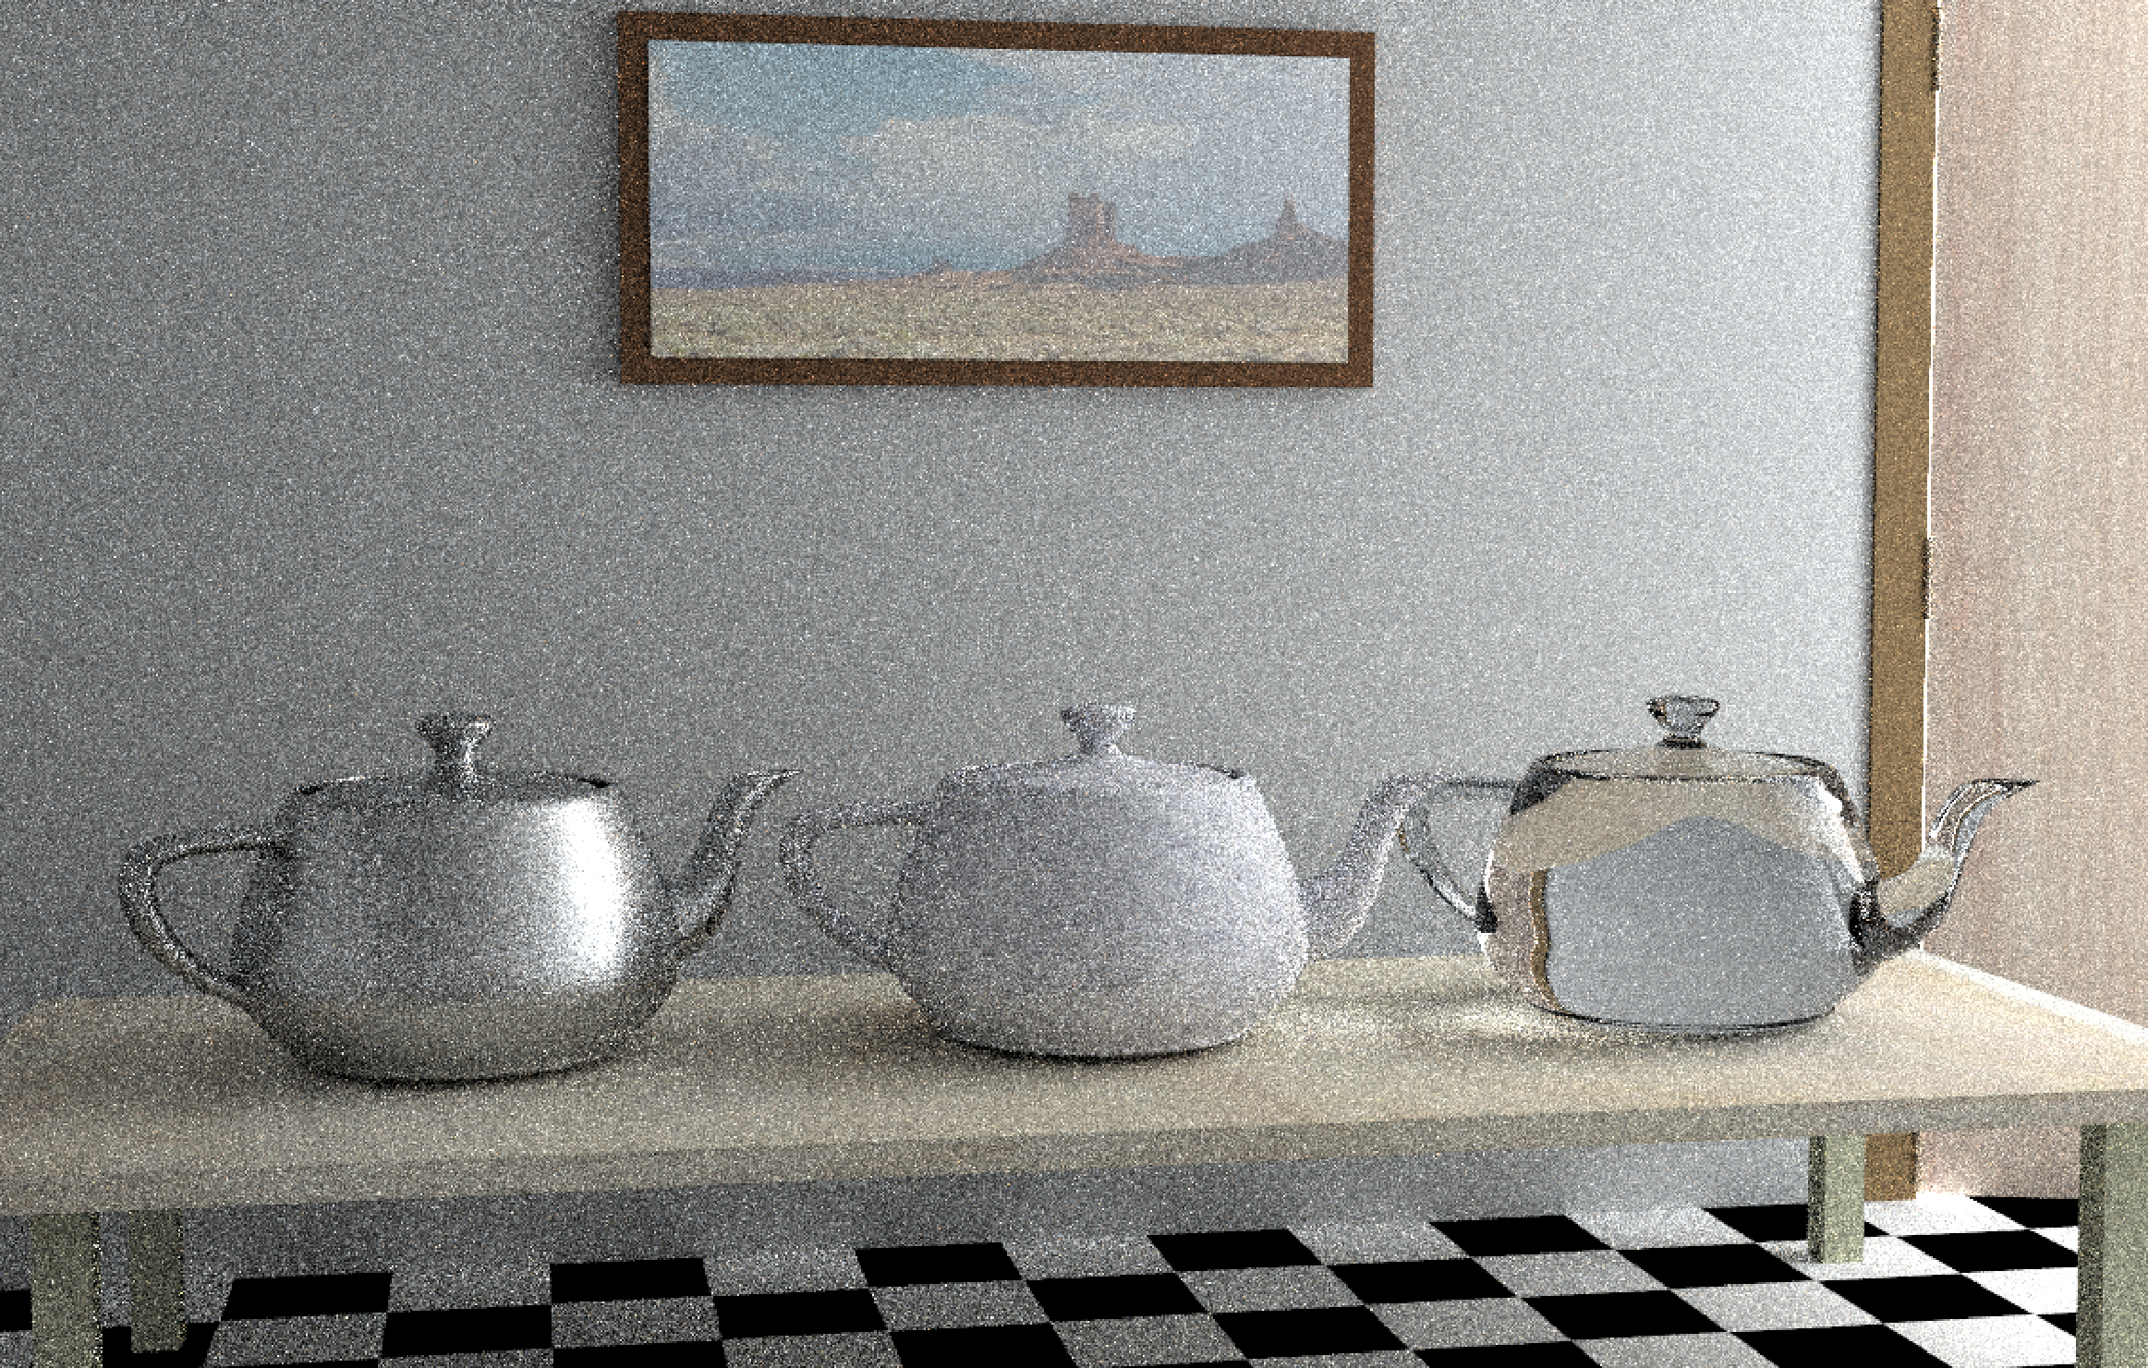
Primary sample space (Multiplexed MLT)
Notes:
On the other hand, the performance of multiplexed MLT is not as good because it needs to recreate the paths for every mutation.

Slide 57
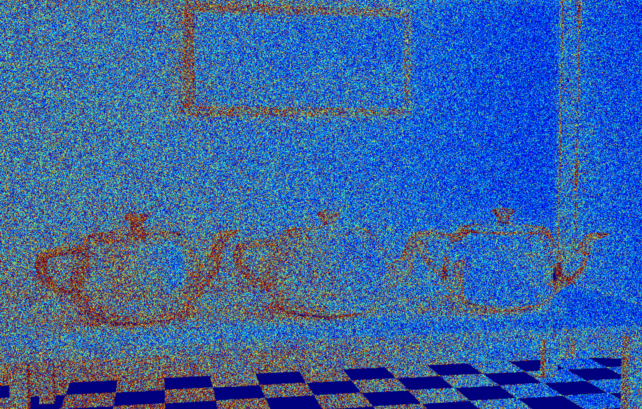
Primary sample space (Multiplexed MLT)
Error: 1.1056
0.0
1.0
Notes:
We can observe a similar tendency from the error image. The scene has a preference to MLT in terms of efficiency.

Slide 58
Ours
Notes:
Our method can render this scene with performance similar to the better [click] one, that is, MLT.

Slide 59
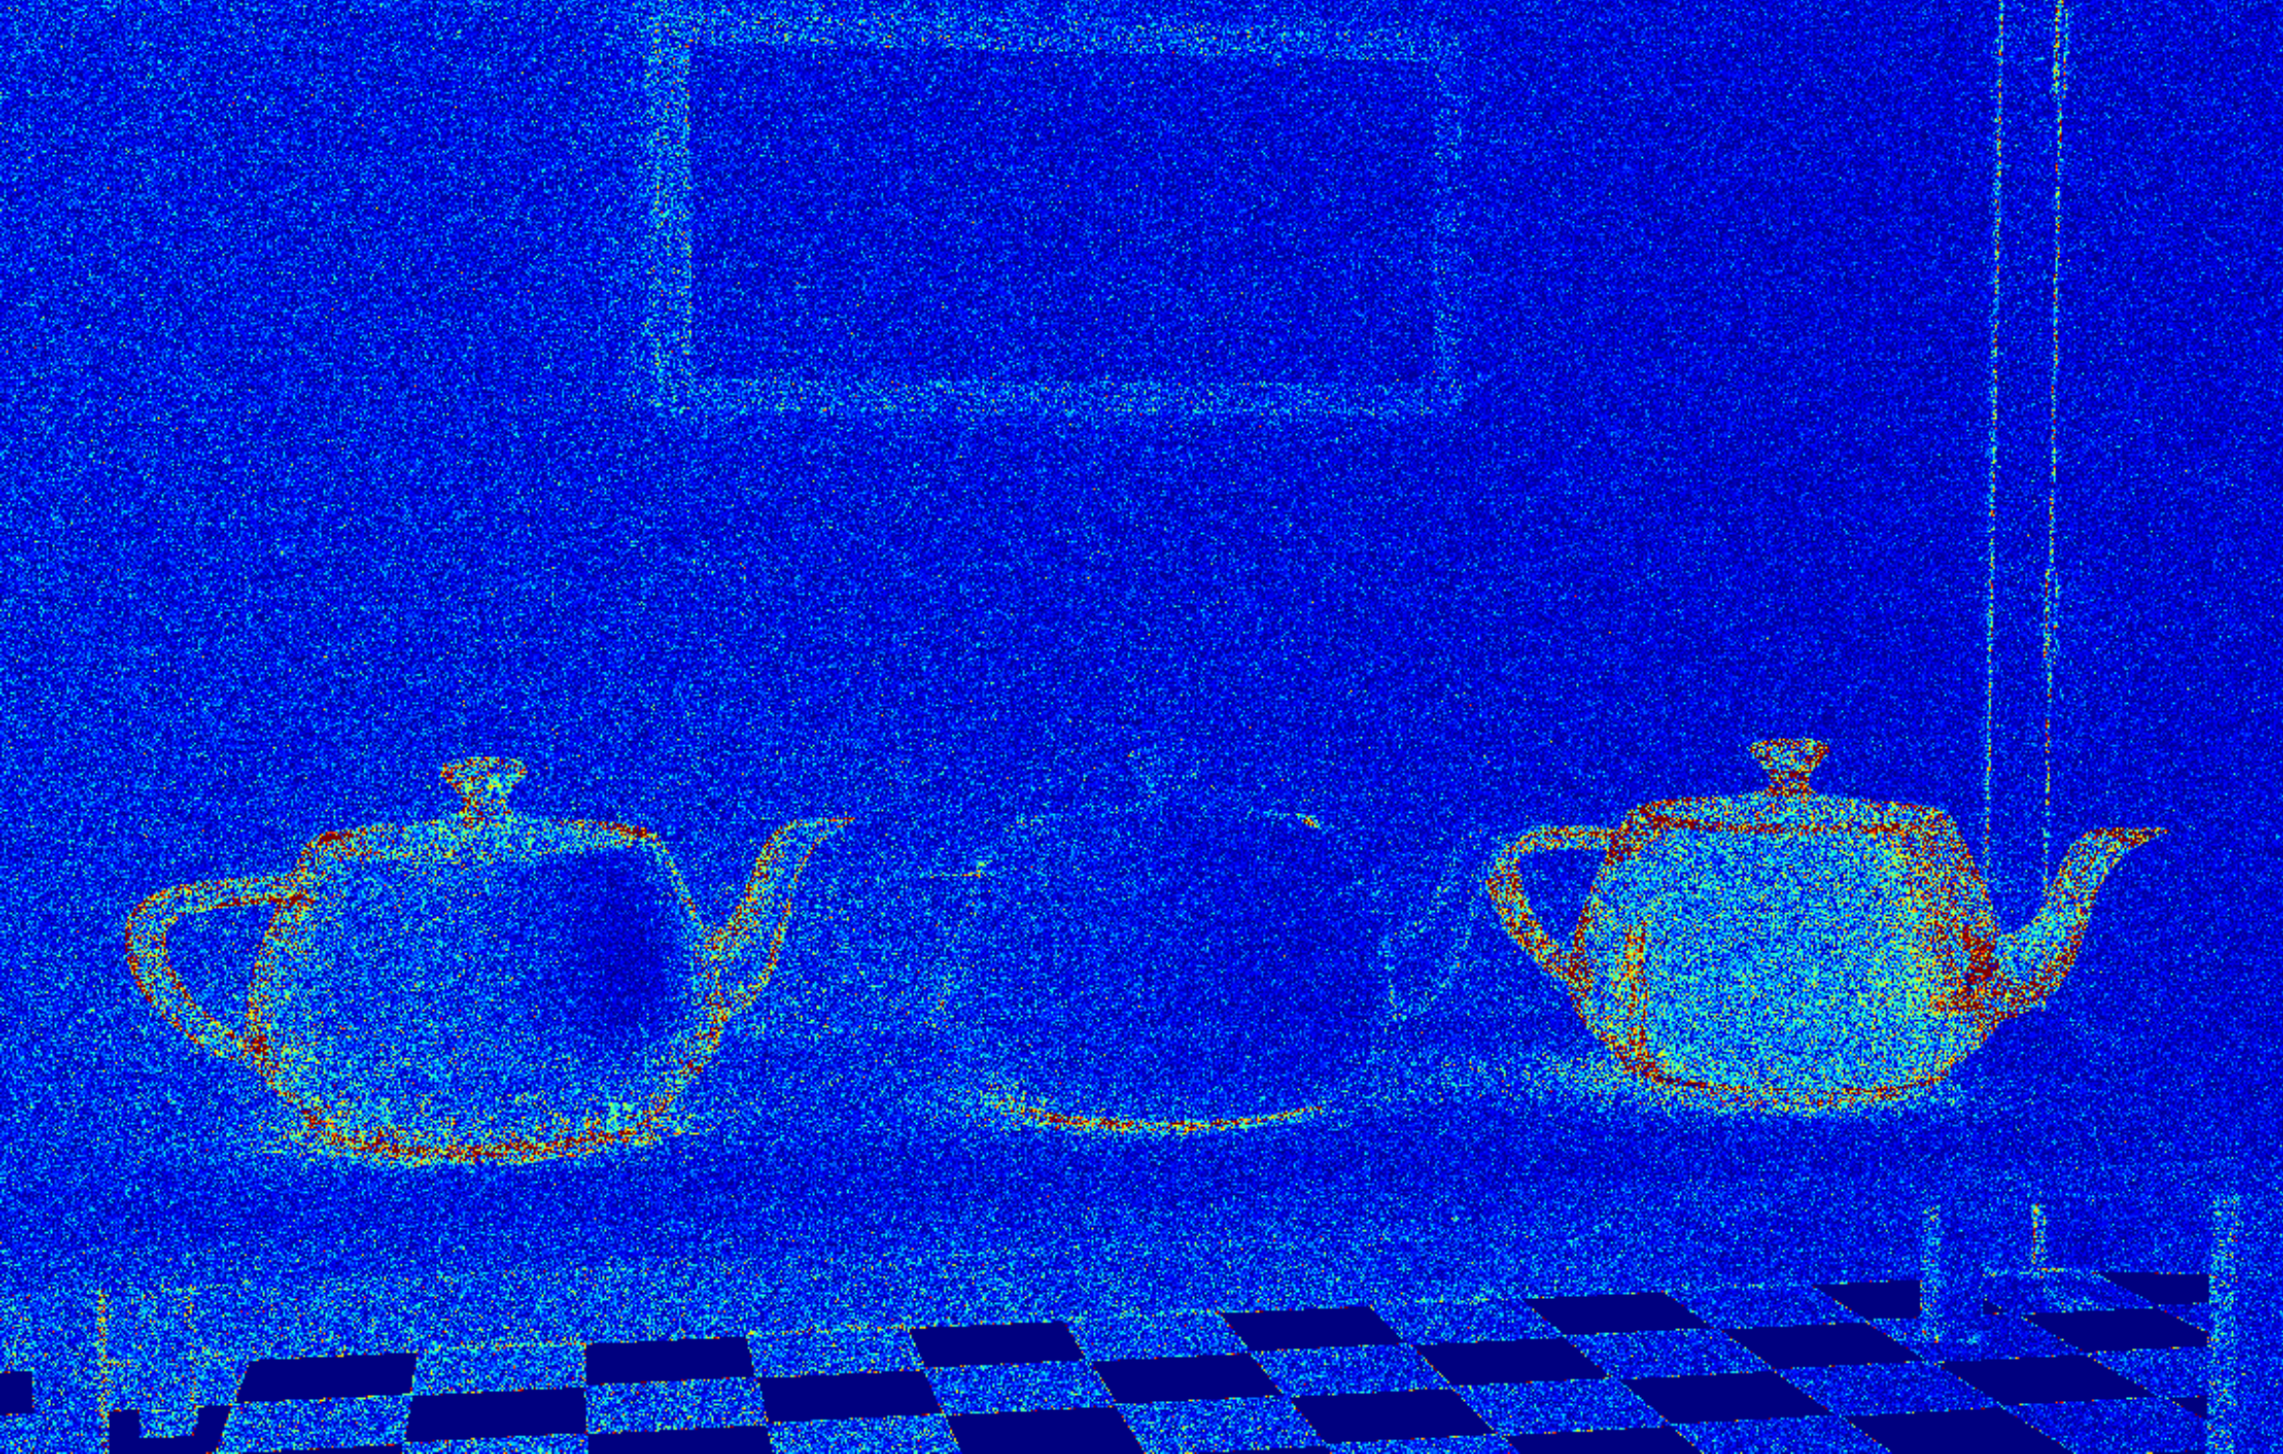
Ours
Error: 0.3537
0.0
1.0
Notes:
Our method can render this scene with performance similar to the better [click] one, that is, MLT.

Slide 60
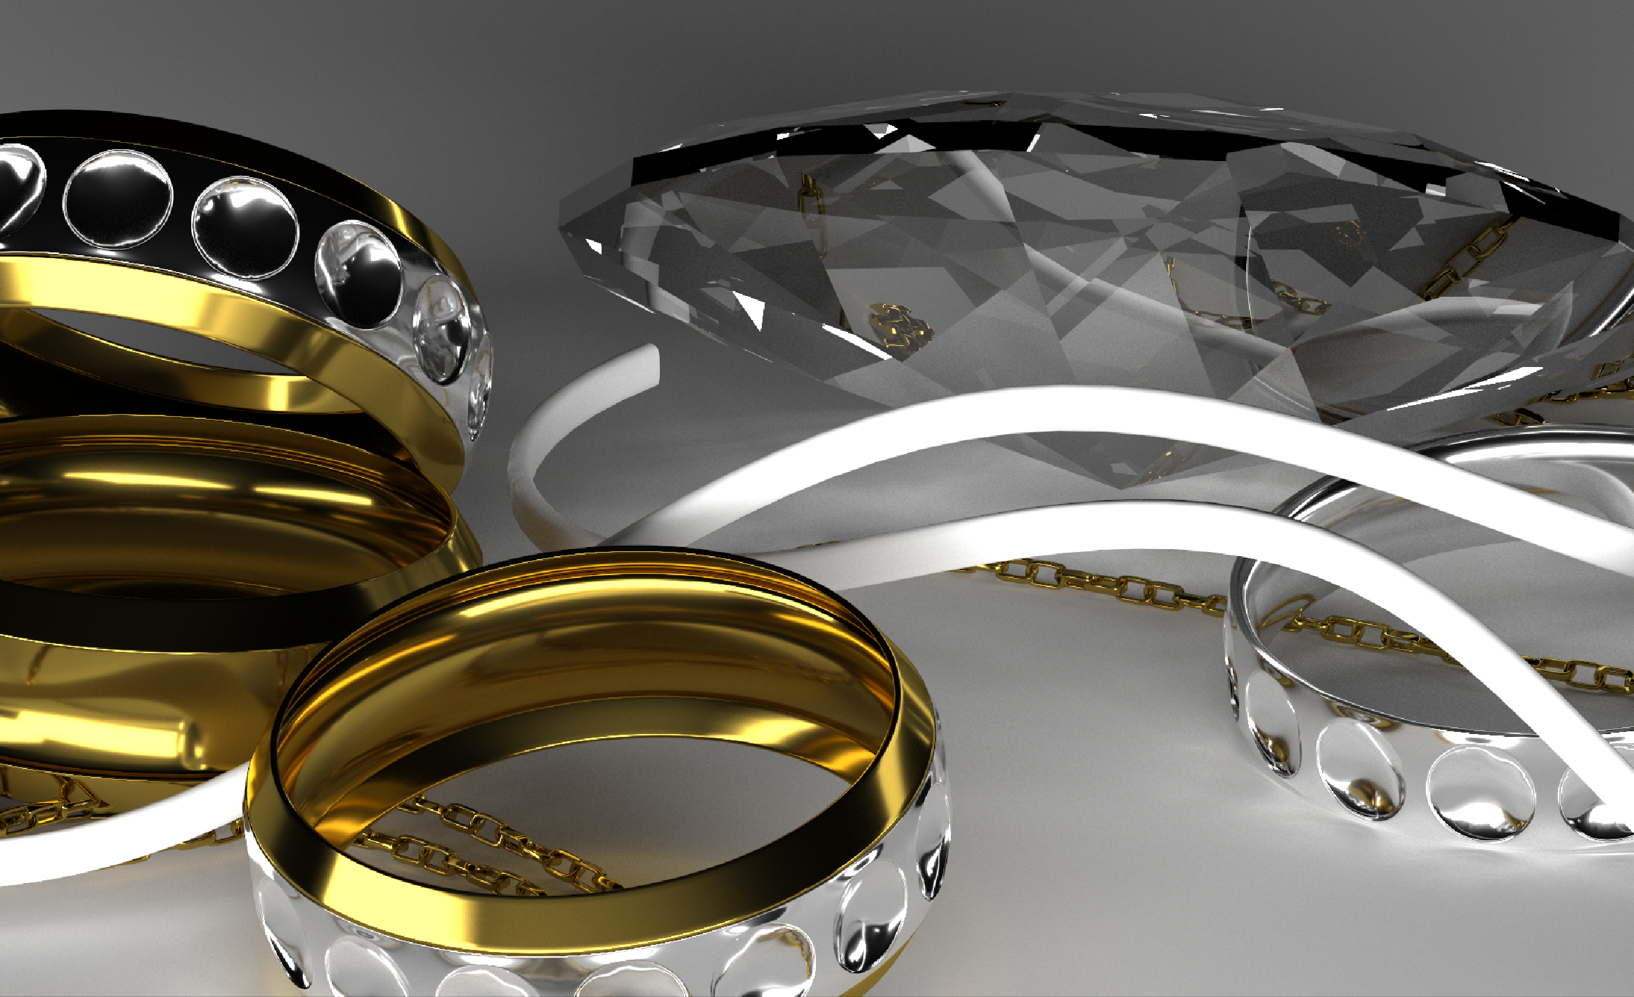
Reference
Notes:
The next scene mainly consists of glossy surfaces illuminated with light sources of different size. This scene is characterized by the complex interreflection between glossy surfaces.

Slide 61
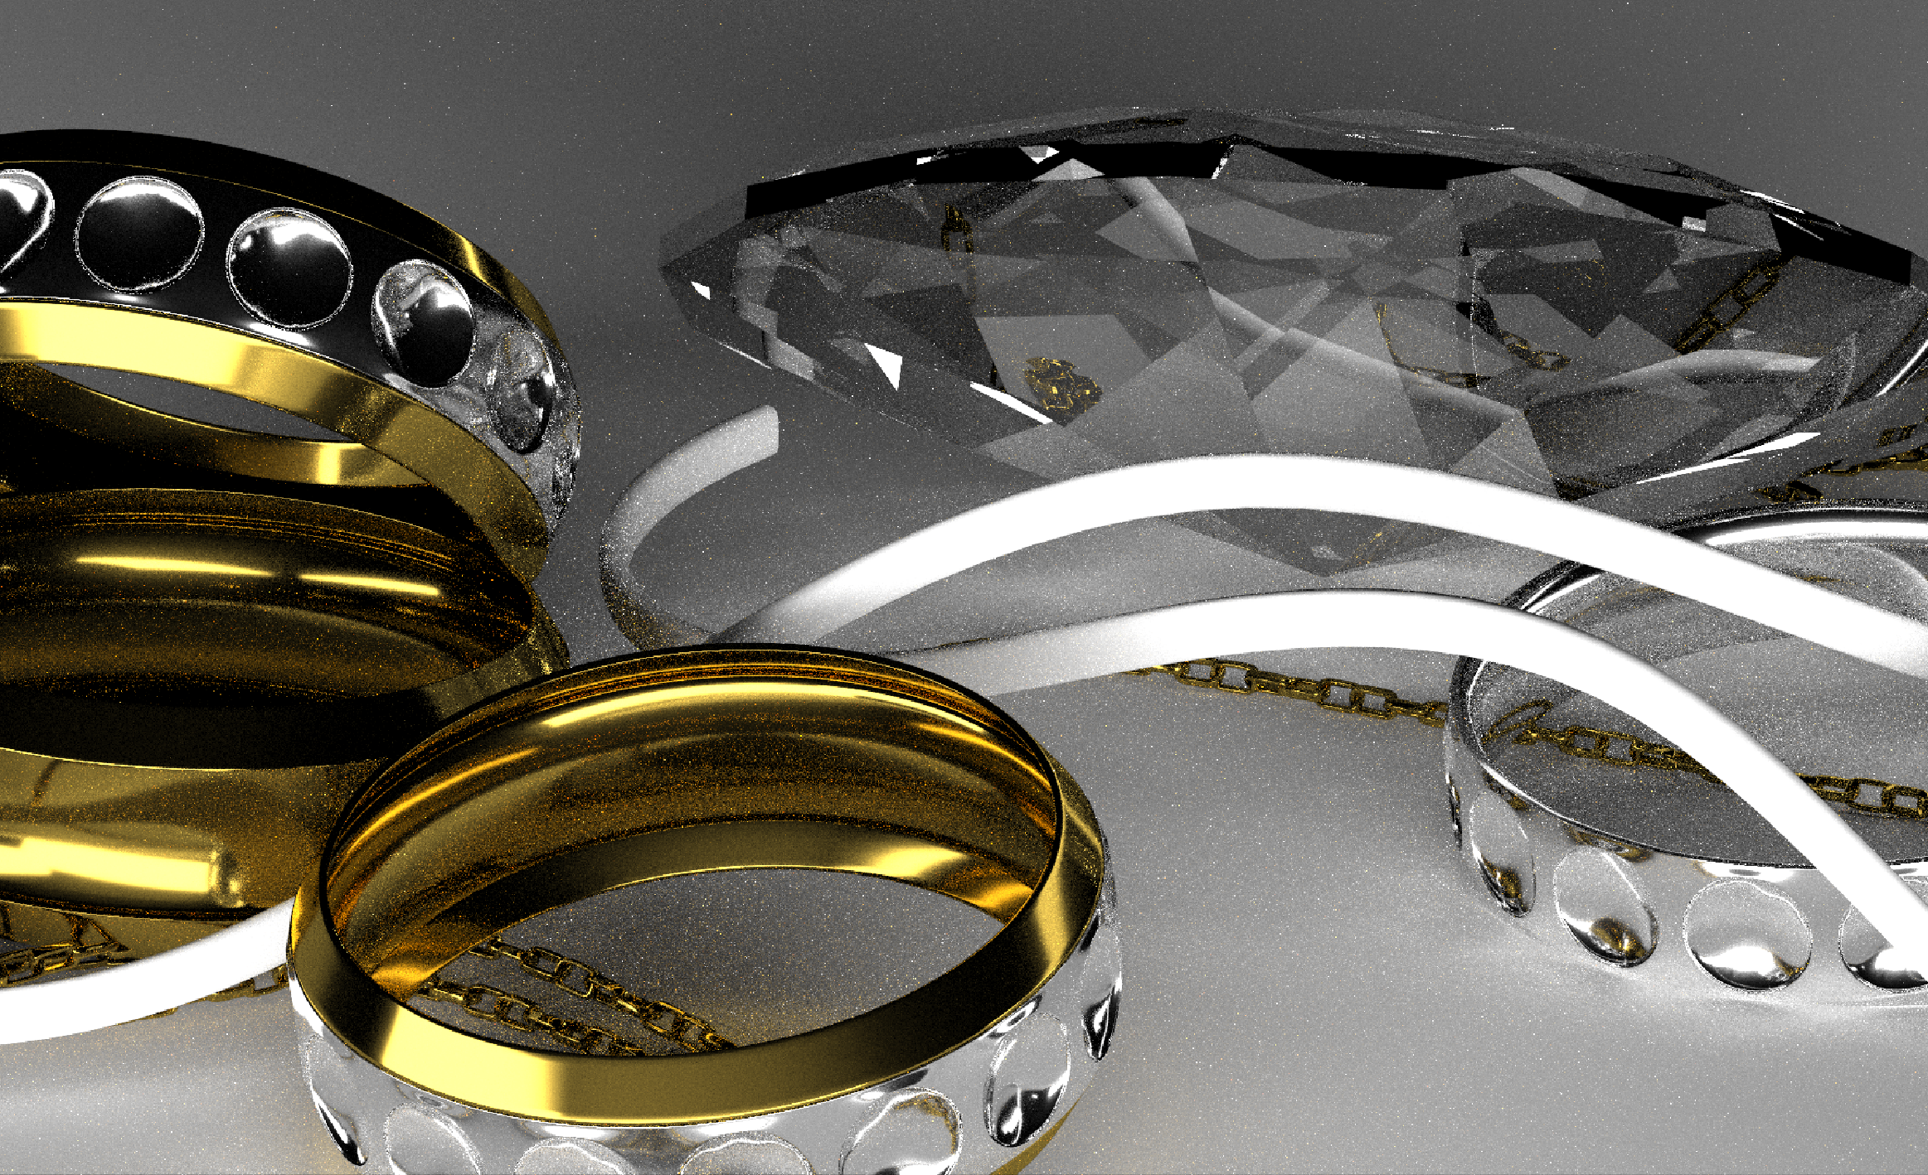
Primary sample space (Multiplexed MLT)
Notes:
This scene is well-suited to multiplexed MLT because the technique utilizes importance sampling in MCMC [click] so it is possible to achieve efficiently global exploration.

Slide 62
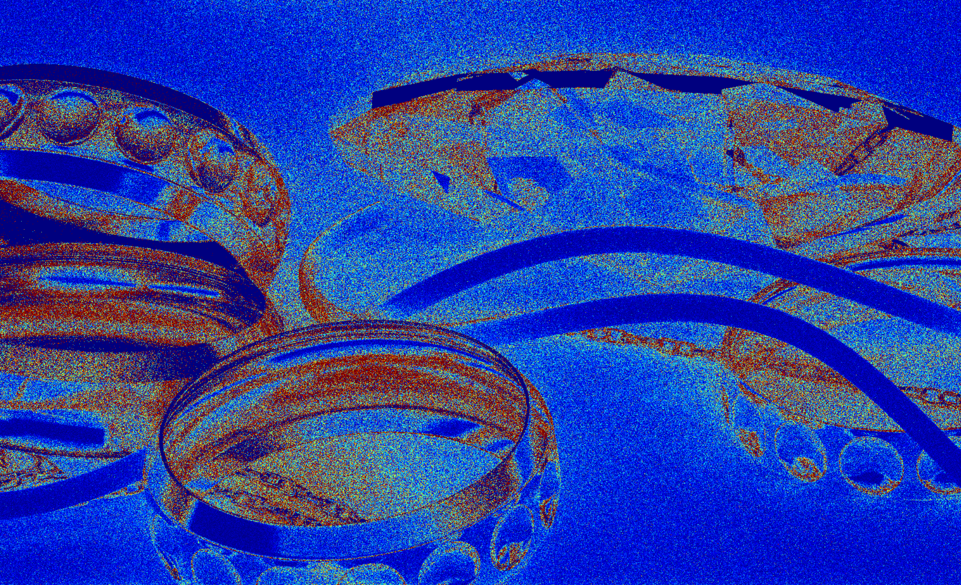
Primary sample space (Multiplexed MLT)
Error: 0.3658
0.0
0.8
Notes:
This scene is well-suited to multiplexed MLT because the technique utilizes importance sampling in MCMC [click] so it is possible to achieve efficiently global exploration.

Slide 63
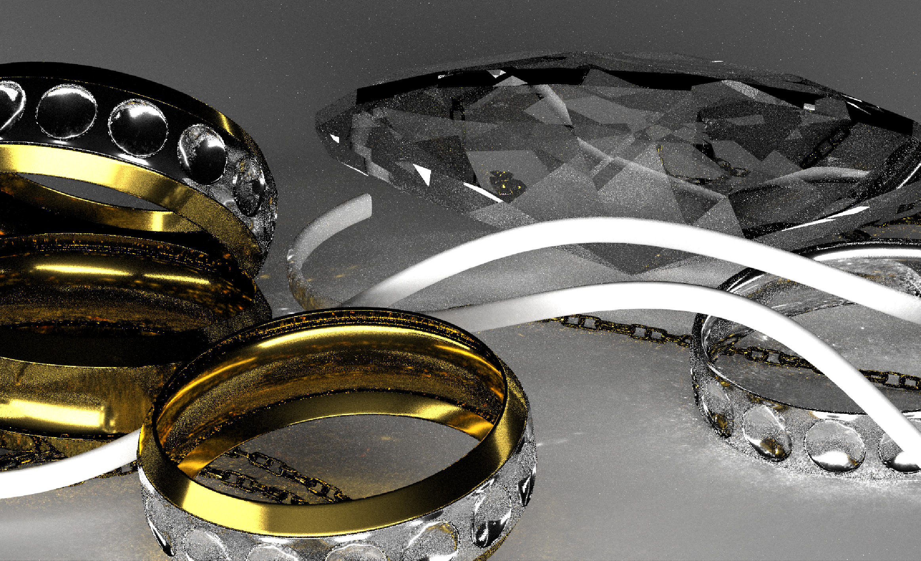
Path space (MLT)
Notes:
On the other hand, MLT is less effective for this scene. The result with MLT contains many artifacts, because the state in the path space tends to be stucked in a local subspace.

Slide 64
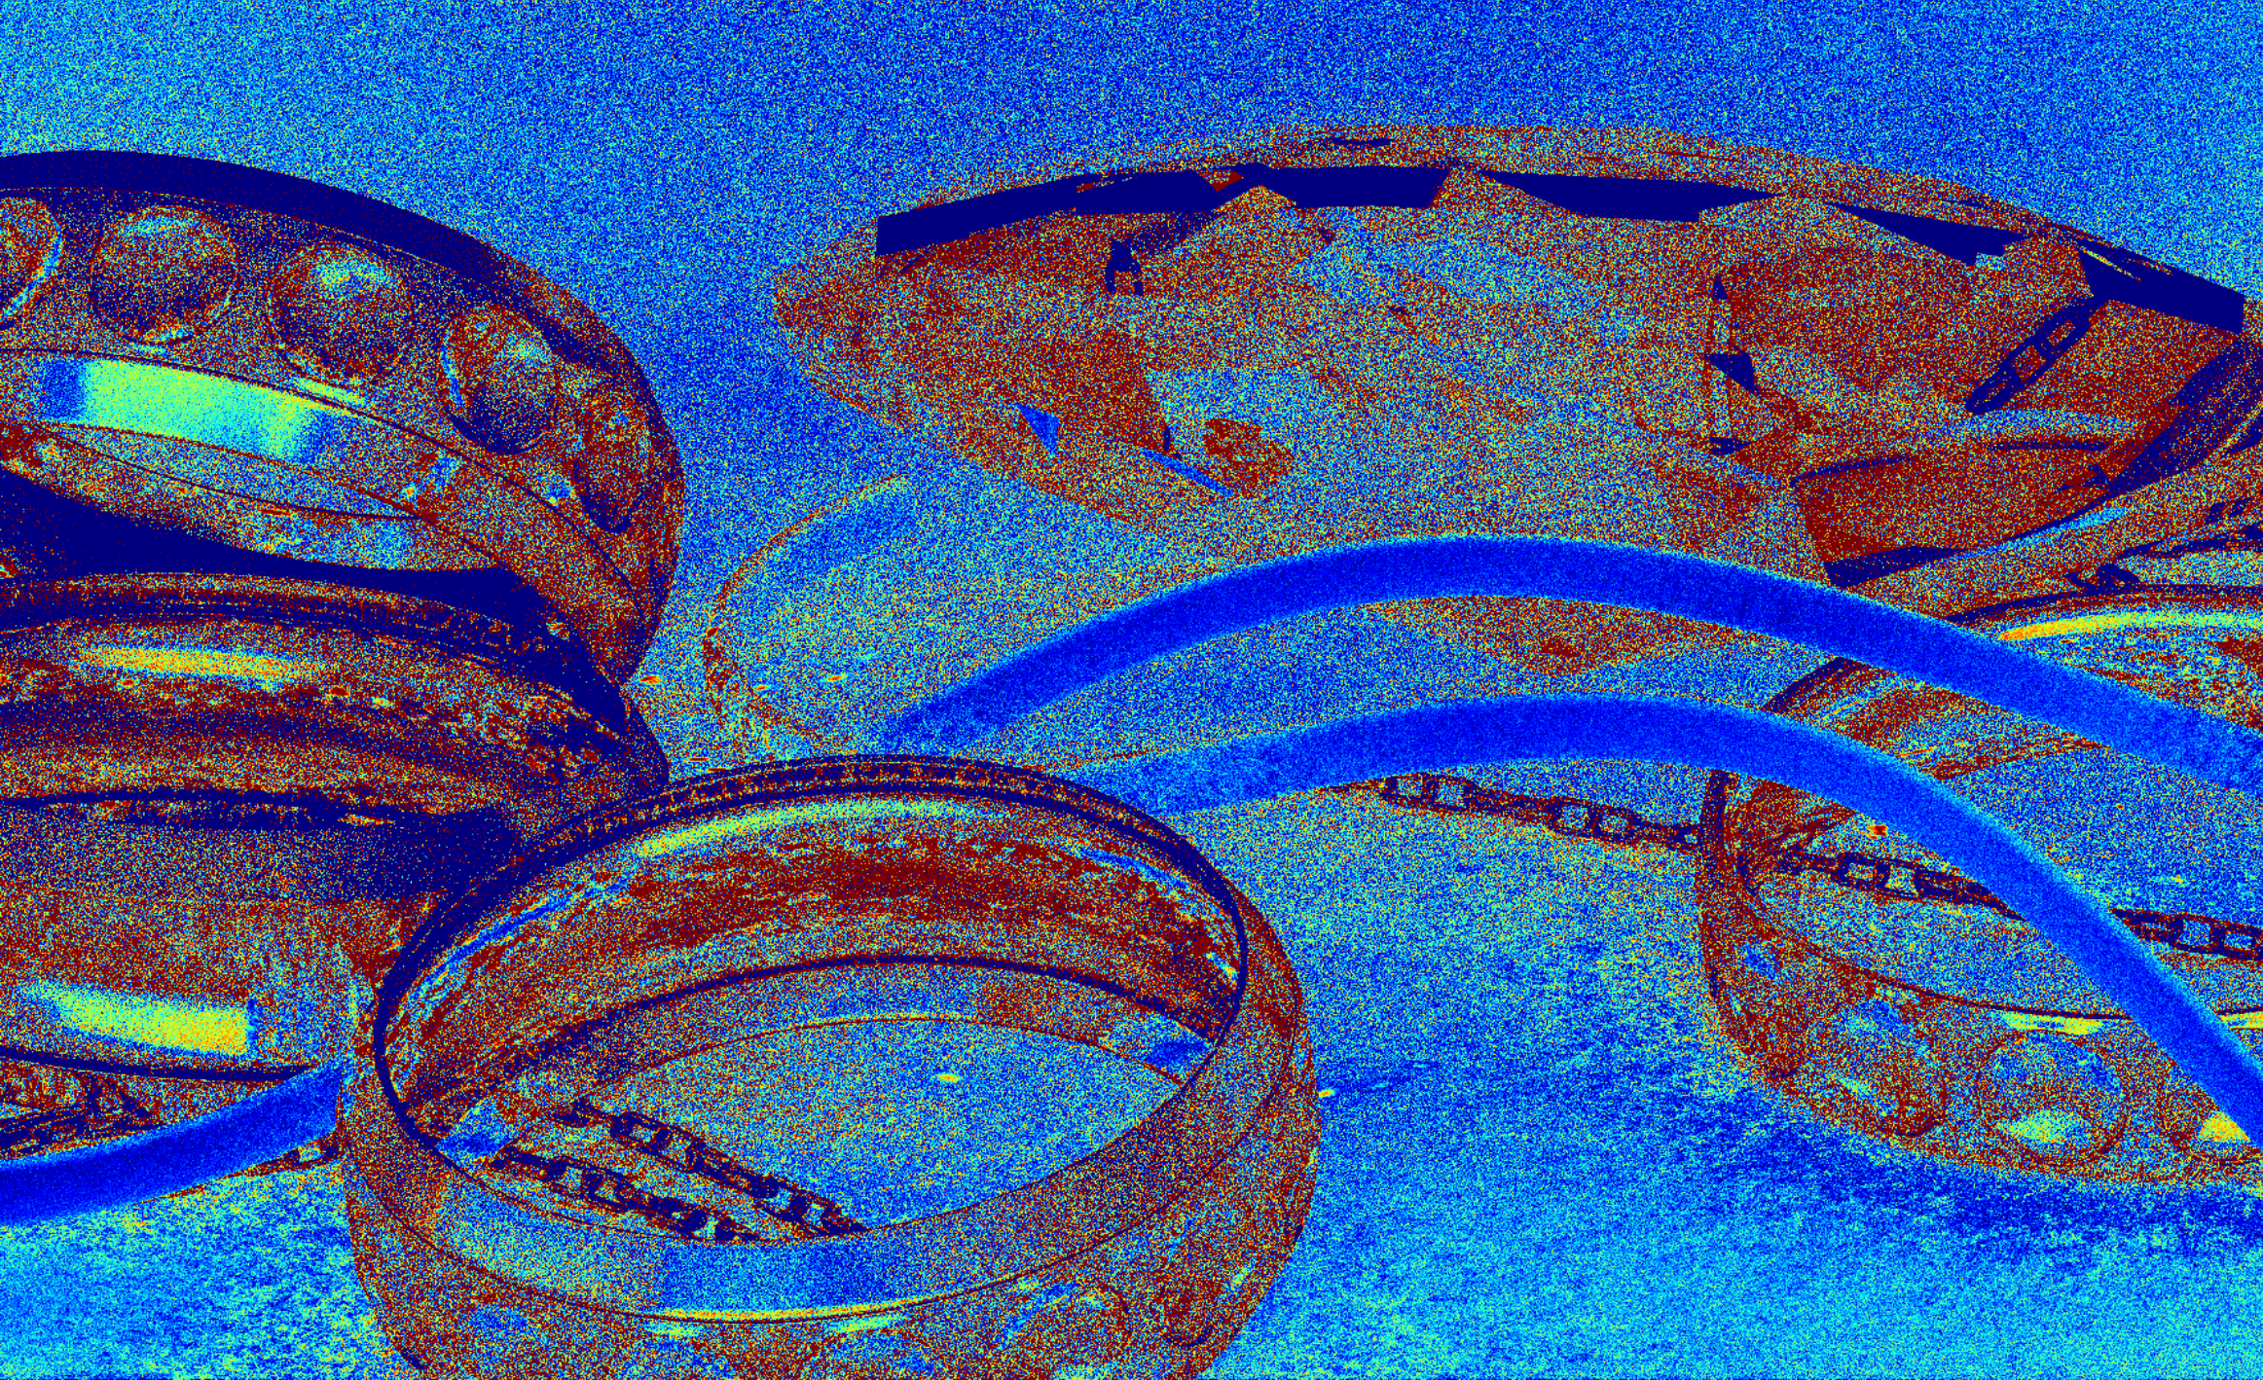
Path space (MLT) Error: 1.3433
0.0
0.8
Notes:
We can also find the artifacts in the error image.

Slide 65
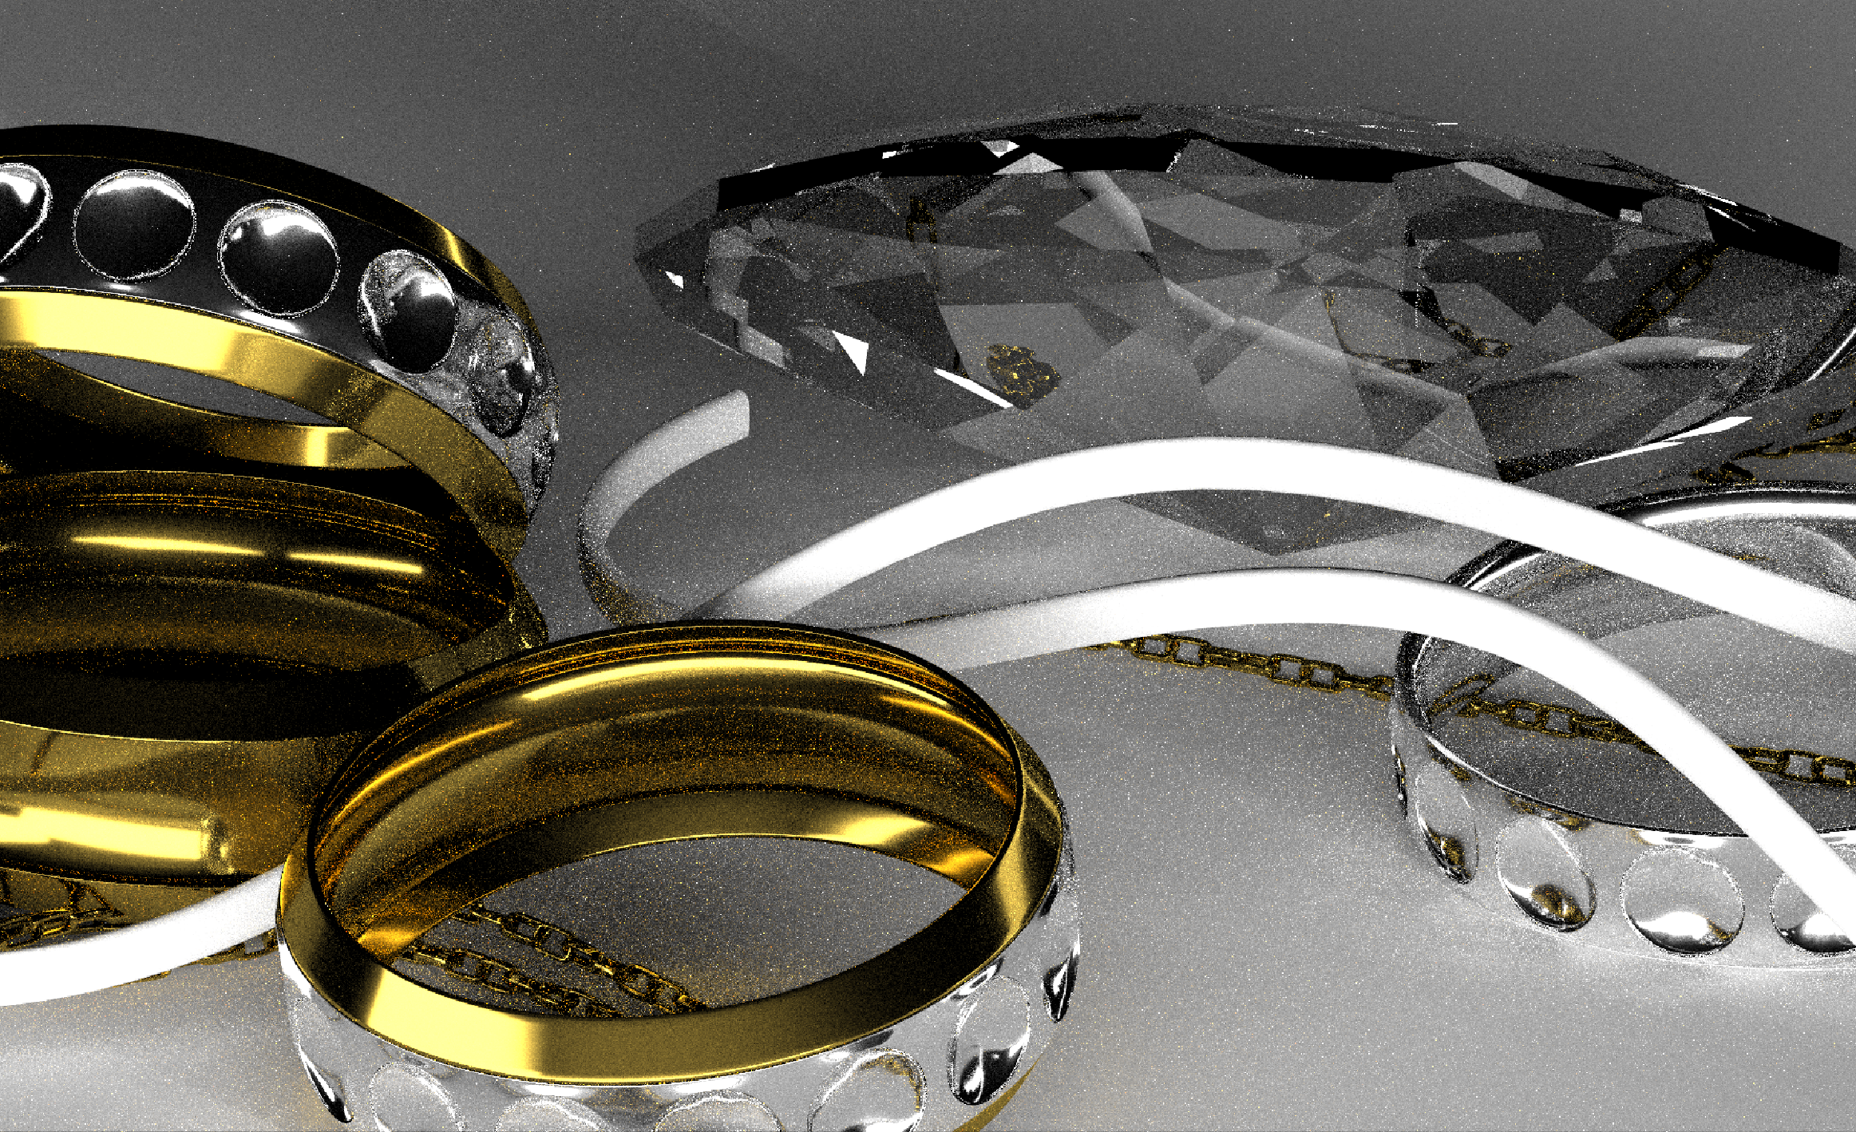
Ours
Notes:
Again, our method can render this scene with similar performance to the better one [click] – in this time, multiplexed MLT.

Slide 66
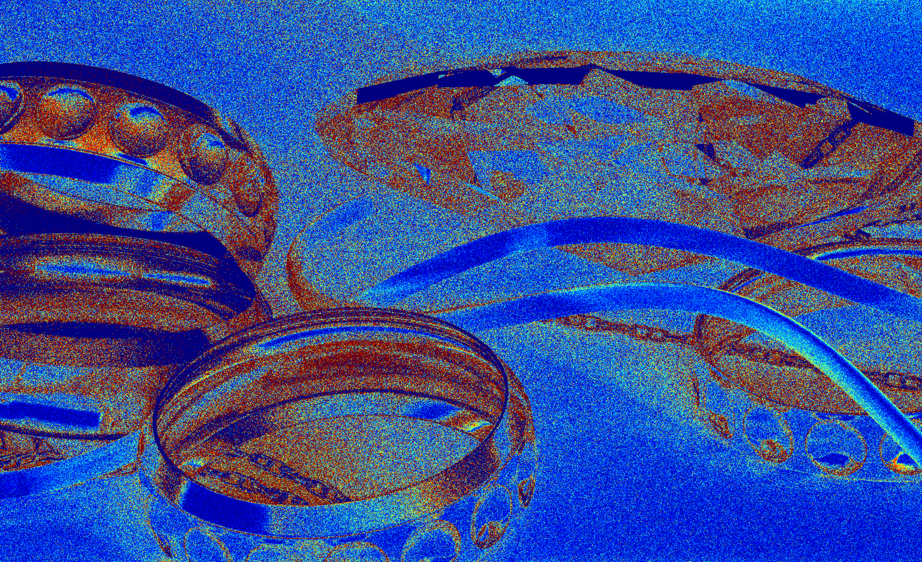
Ours
Error: 0.6442
0.0
0.8
Notes:
Again, our method can render this scene with similar performance to the better one [click] – in this time, multiplexed MLT.

Slide 67
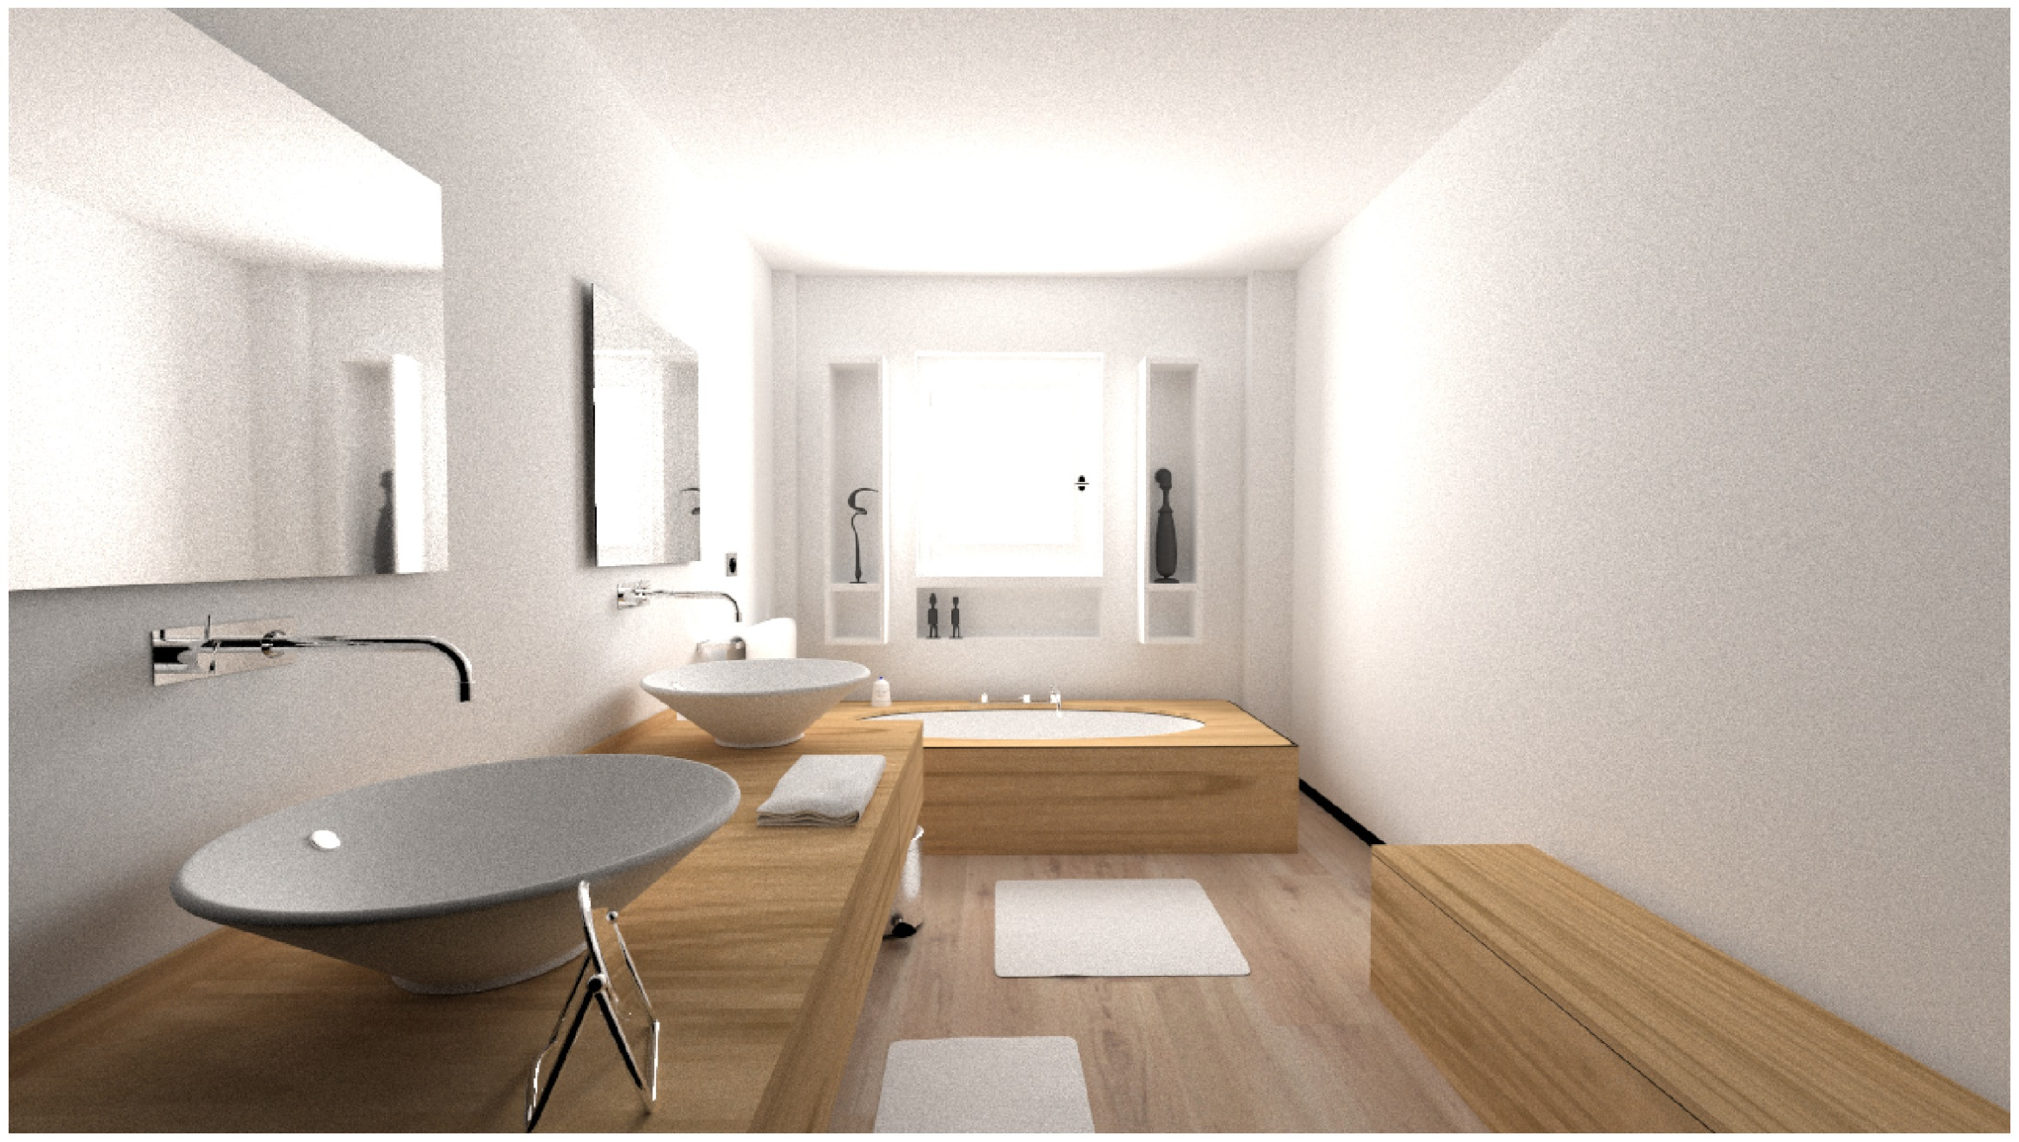
Reference
Notes:
The last scene contains diffuse surfaces and highly-glossy surfaces. Unlike the previous results, this scene shows a trade-off between multiplexed MLT and MLT in one image.

Slide 68
MLT
Multiplexed MLT
Ours
Notes:
The red inset indicates the part of the scene [small pause] seen through the mirror modeled with a highly glossy surface. Multiplexed MLT can render this part more efficiently than MLT, and our method shows similar performance [click, showing erorr image] to multiplexed MLT.

Slide 69
MLT
Multiplexed MLT
Ours
Notes:
The red inset indicates the part of the scene [small pause] seen through the mirror modeled with a highly glossy surface. Multiplexed MLT can render this part more efficiently than MLT, and our method shows similar performance [click, showing erorr image] to multiplexed MLT.

Slide 70
MLT
MLT
Multiplexed MLT
Multiplexed MLT
Ours
Ours
Notes:
On the other hand, as shown in the blue inset, the part of the scene with diffuse surfaces is more efficient using MLT. Again our method shows similar performance [click, to show error image] to the better one, in this case, MLT.

Slide 71
MLT
Multiplexed MLT
Ours
Notes:
On the other hand, as shown in the blue inset, the part of the scene with diffuse surfaces is more efficient using MLT. Again our method shows similar performance [click, to show error image] to the better one, in this case, MLT.

Slide 72
Limitations
Handling the case of a cumulative distribution function where the analytical form does not exist
e.g., Woodcock tracking
Numerical precision of inverse path sampler
Double precision
Numerical guards
Notes:
Finally we will discuss the limitations of our method. One major limitation is that [click] our approach depends on the existence of the analytical cdf. So our approach cannot handle the case with, for instance, rejection based approaches like Woodcock tracking.
Also, some sampler functions can introduce numerical issues when we consider the inverse mapping. In actual implementation, we use double precision and introduce several numerical guards to alleviate the issue.

Slide 73
Conclusion
Novel MCMC rendering framework
Fuses two different state spaces into one framework
Introduces the concept of an inverse path sampler
Resolves the trade-off between MLT and Multiplexed MLT
Notes:
Conclusion.
In this presentation, we proposed a novel MCMC based rendering framework to fuse two different state spaces into one, using the idea of an inverse path sampler. With our framework, we demonstrated a combination of the mutation techniques in MLT and multiplexed MLT. The results indicate our approach resolves the trade-off between the two approaches.

Slide 74
Code is available on the project site!
http://lightmetrica.org/h-otsu/project/inverse/
Notes:
This is the end of my talk. Thank you.

Slide 76
Supplemental slides

Slide 77
Actual state space
Uses multiplexed primary sample space [Hachisuka et al. 2014] for bidirectional case
Notes:
Now we want to think about to integrate bidirectional techniques as a path sampler to our framework.
We adopted to use a state space called the multiplexed primary sample space,
which extends the primary sample space with a index of the connection strategy, typically denoted by t [click].

Slide 78
Actual state space
Uses multiplexed primary sample space [Hachisuka et al. 2014] for bidirectional case
$$t$$
For eye subpath
For light subpath
For connection
Notes:
Actually we uses
A sequence of numbers for generating eye subpaths
A sequence of numbers for generating light subpaths
And an index of the connection strategy.

Slide 79
Actual state space

Slide 80
Actual state space
Notes:
The sequence of samples are utilized to generate each of the subpaths originated from the eye [click] and from the light respectively.

Slide 81
Actual state space
Notes:
The sequence of samples are utilized to generate each of the subpaths originated from the eye [click] and from the light respectively.

Slide 82
Actual state space
Notes:
The sequence of samples are utilized to generate each of the subpaths originated from the eye [click] and from the light respectively.

Slide 83
Actual state space
Notes:
We can obtain a valid path connecting the two vertices from each subpath.

Slide 84
Actual state space
$$t$$
$$t−1$$
$$t+1$$
Notes:
The index of connection strategy determines one strategy among them.

Slide 85
Actual state space
Notes:
Using the multiplex primary sample space, we can faithfully construct inverse path sampler and make it possible to integrate the bidirectional path sampler into our framework.

Slide 86
Actual state space
$$t$$
Notes:
Using the multiplex primary sample space, we can faithfully construct inverse path sampler and make it possible to integrate the bidirectional path sampler into our framework.

